Slide 1
March 22, 2017
Text mining in R
Examples from TwitteR
Laxman Panthi

Slide 2
Agenda
Introduction
Required Packages
Using Twitter API in R
Importing unstructured data from twitter
Sentiment Analysis
Word Cloud

Slide 3
Introduction
What is text mining?
Large volumes of text can be mined to automate the process of finding patterns from raw data using tools like word-cloud and sentiment analysis.

Slide 4
Setting up the twitter API
We need to get permission access tokens to use Twitter API. To do this, the first step is to make an account on twitter (if you don’t have one).
Go to https://dev.twitter.com/
Sign into your twitter account.
Go to manage my apps at the bottom of the page
Click on create a new app
Enter the information to fill up the form and agree to terms & conditions.

Slide 5
Generate the keys and tokens
The previous steps will generate your consumer key and secret
To generate Access Token - click on “Create my access token”
api_key <- "xxxxxxxxxxxxxxxxxxxxxxxxxxxxxxx"
api_secret <- "xxxxxxxxxxxxxxxxxxxxxxxxxxxxxxxxxxxx"
access_token <- "xxxxxxxxxxxxxxxxxxxxxxxxxxxxxxxxxx"
access_token_secret <- "xxxxxxxxxxxxxxxxxxxxxxxxxxxx"

Slide 6
Required packages
Install the following packages in R required for text mining in R
twitteR
ROAuth
Httr
Plyr
Stringr
Ggplot2
Plotly
pkgs <-c('twitteR','ROAuth','httr','plyr','stringr','ggplot2','plotly', ‘TM’, ‘RColorBrewer’, ‘wordcloud’) for(p in pkgs) if(p %in% rownames(installed.packages()) == FALSE) {install.packages(p)} for(p in pkgs) suppressPackageStartupMessages(library(p, quietly=TRUE, character.only=TRUE))

Slide 7
Sync my github REPO
My github repo is available in: https://github.com/theQI/R-text-mining
Download and sync using desktop client or
Use command:
$ git clone “https://github.com/theQI/R-text-mining”

Slide 8
Importing and cleaning the data
Authenticate the twitter app using the api keys
Download data using the twitter packages.

Slide 9
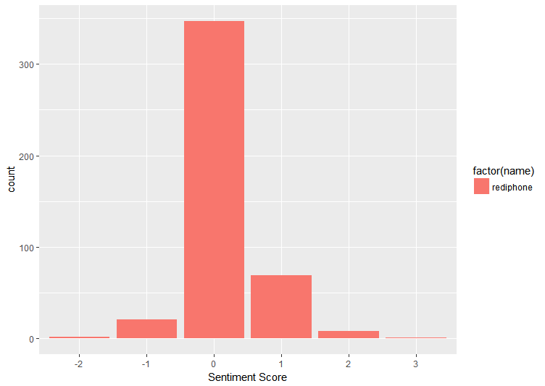
Sentiment Analysis
Make sure you have negative-words.txt and positive-words.txt downloaded to the same directory

Slide 10
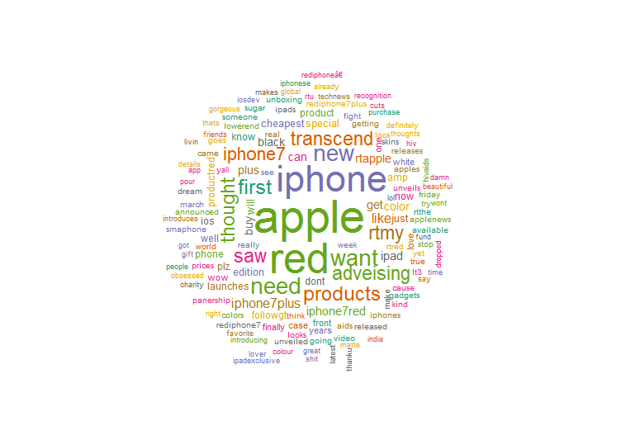
Word Cloud
We will use the wordcloud package to create a word cloud by the frequency of words in the twitter timeline.

Slide 11
Enjoy it!

